Slide 1


STAT473 Project: Predicting Next Pitch
By RJ Burson

Slide 2
Research Goals
Predict if a fastball or an offspeed pitch will be thrown on the next pitch.
-“Guessing what the pitcher is going to throw is 80% of being a successful hitter. The other 20% is just execution.” -Hank Aaron
Which variables are most important when trying to predict what pitch that will be thrown on the next pitch?

Slide 3
Data Set
Baseballsavant.mlb.com
Use Trackman software in MLB stadiums to track all sorts of data.
Every pitch thrown by Kershaw over a two-year span(2015-2016)
Chose all the variables that have to do with game situation.
999 obsersvations with 14 predictors.

Slide 4
Data Set Variables
Stand – batter handedness (1=right, 0=left)
Balls – How many balls are in the count
Strikes – How many strikes in the count
Outs_when_up – how many outs
Inning – What inning it is
home_score _ Score of the Home Team
away_score – Score of the Away Team
runner_on_1 – if there is a runner on first(1=yes,0=no)
runner_on_2 - if there is a runner on second(1=yes,0=no)
runner_on_3 - if there is a runner on third(1=yes,0=no)

Slide 5
Choosing Variables
When attempting first models kept getting errors of multicollinearity
Used vif() function to get variance inflation factors. Value over 10 is high.
Removed at_bat_number it has multicollinearity with inning. Removed pitch_number because it is associated with balls and strikes.
After removing these variables all vif values were around 1.

Slide 6

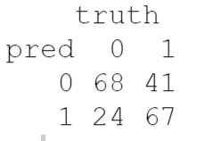
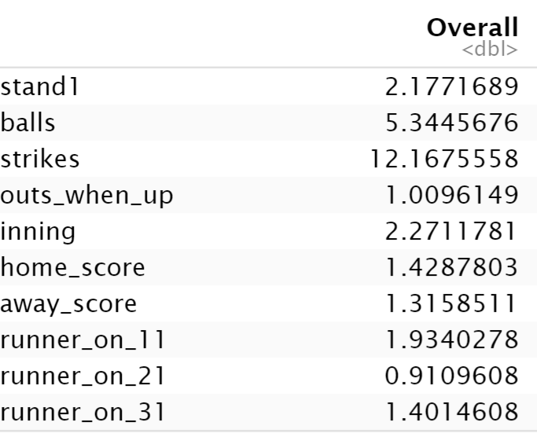
Initial Logistic
- After splitting the data into 80% in the training set and 20% in the testing set.
- Fit a glm() with all the variables minus at_bat_number and _pitch_number
Model Accuracy of .675
AUC: 0.7176932
- This is the baseline model to compare all other models to.
- Using the varImp() function found the most important variables appear to be strikes, balls, inning, and stand. With strikes standing out as the most important predictor.

Slide 7
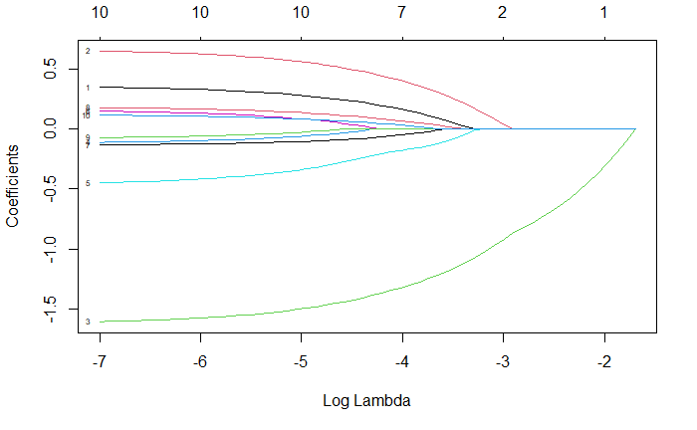
Lasso Model
Lasso regression shows no coefficients go to zero. Strikes, balls, inning, and stand look to be most significant variables.

Slide 8
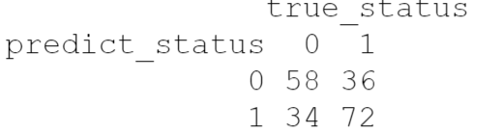
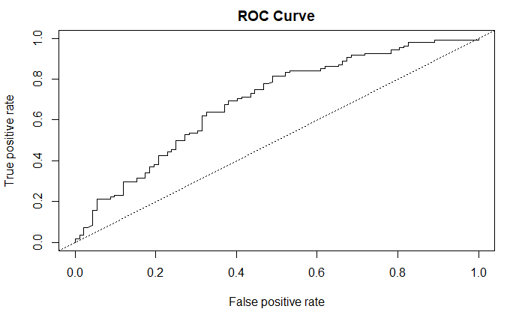
QDA model
Fit a qda() with all variables
Only an accuracy of .65
AUC of 0.6907206
The QDA model performs worse than the logistic

Slide 9
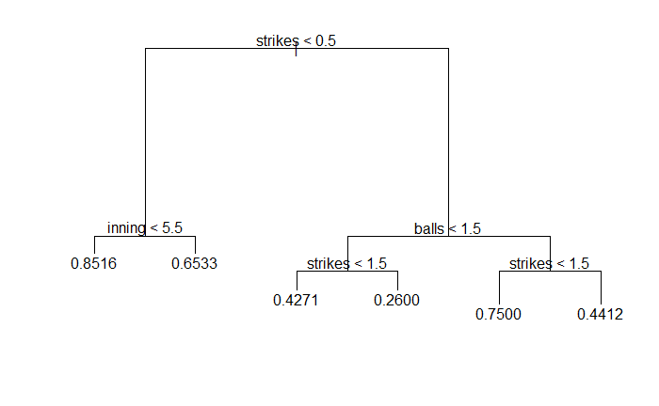
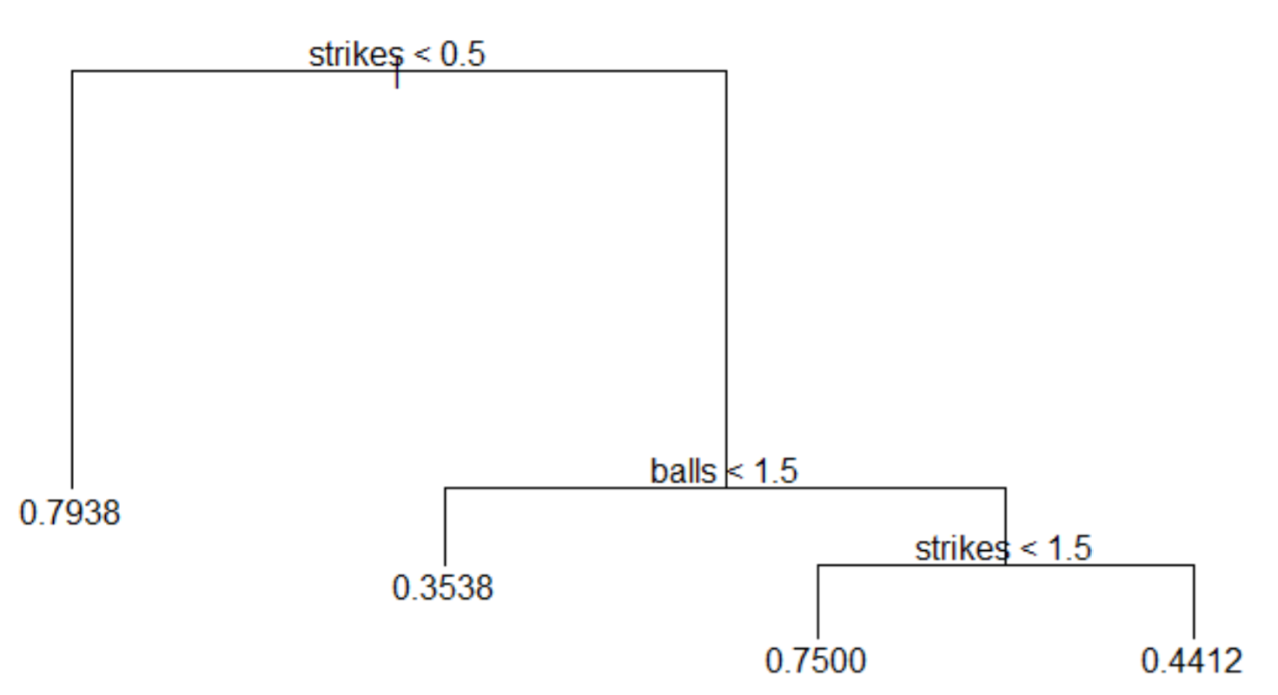
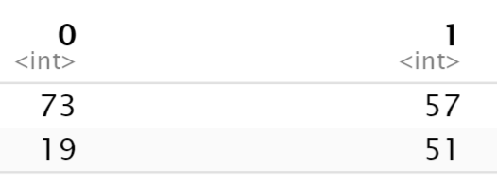
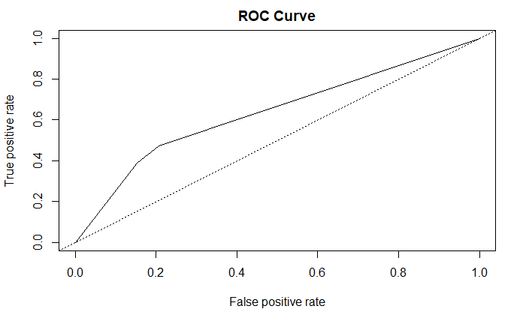
Classification Tree
First fit tree with all variables and got a model with 6 terminal nodes. Pruned the model to the tree on the right.
This pruned tree has an accuracy of .62
AUC value of 0.6372283
This model also performs worse than the logistic model

Slide 10
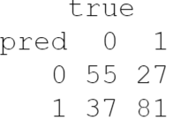
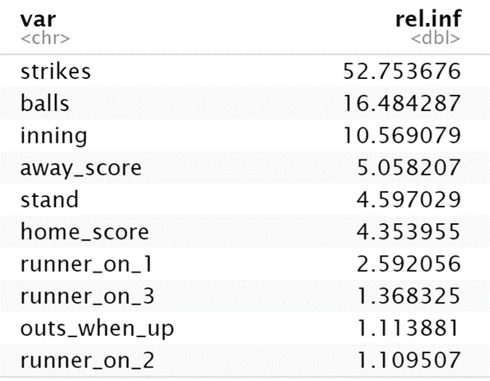
Boosting Model
- Tuned with 200 trees and shrinkage of .2
- Has a 0.68 model accuracy
- Same variables look to be important as in the previous models(strikes, balls, and inning).

Slide 11
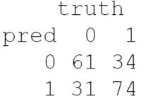
SVM with Linear Kernel
Chose linear kernel because it performed the best out of the 3 svm models
Used tune svm to create a svm classifier. The cost range was seq(.01, 10, length.out=10))).
Cost of 2.23
Model Accuracy is .675

Slide 12
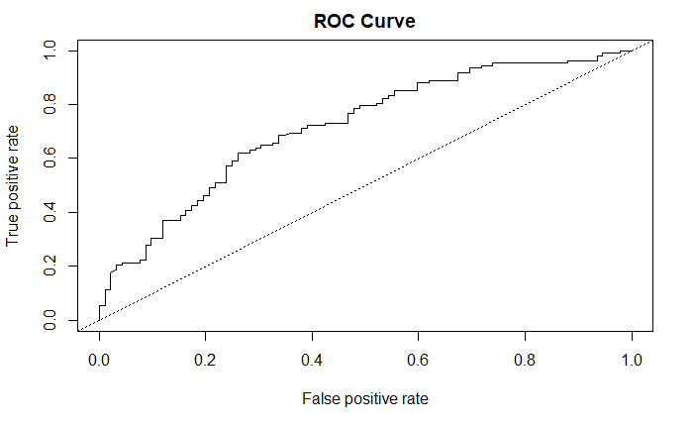

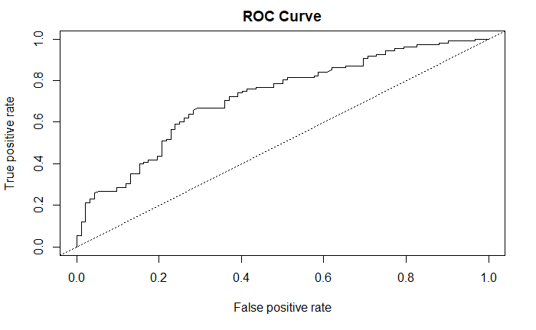
Model Selection
Logistic Model
Linear SVM Model
Boosting Model
Model Accuracy: 0.675
AUC: 0.7176932
Model Accuracy: .675
AUC: 0.7109501
Model Accuracy: .68
AUC: 0.7205616

Slide 13
Summary
The boosting model predicts the next pitch the best. Had the best model accuracy and AUC value.
Challenging part of predicting the next pitch is that pitchers attempt to pitch mix as much as possible and not fall into patterns. I think being able to predict fastball or offspeed at about a 70% rate is pretty good.
The most important variables when it comes to predicting the next pitch are strikes, balls, inning , and inning.
Future work. Try and apply to other pitchers
Could include adding the catcher behind the plate to see if the catcher has any effect on predicting the next pitch. Maybe pitcher is more confident to throw offspeed.
Or adding which runner is on base. If a fast runner is on base it could increase the amount of fastballs thrown to stop the running game.

